Slide 1
Java programming
Integrated Development Environment - IDE

Slide 2
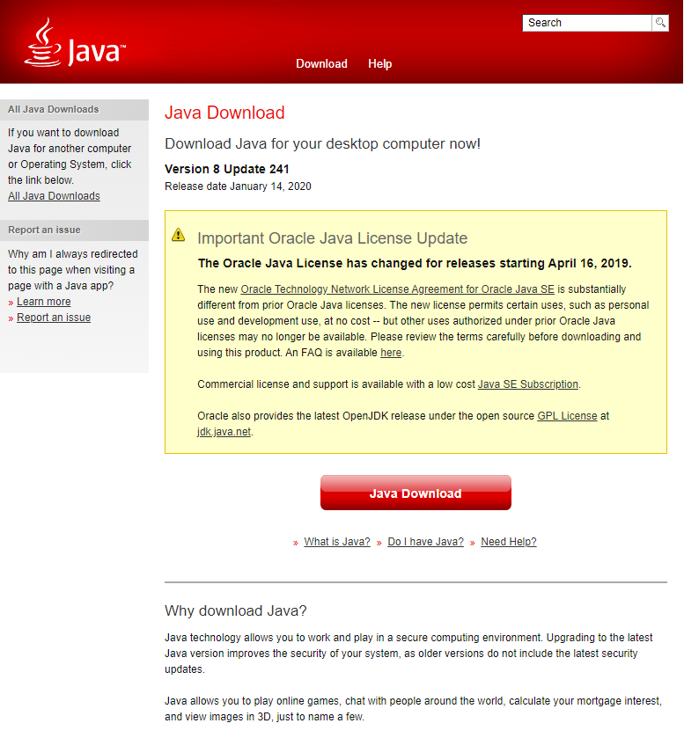
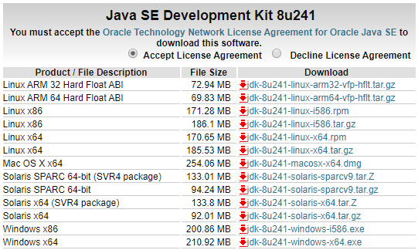
Java – Install
JRE v8
https://www.java.com/en/download/win10.jsp
JDK v8
https://www.oracle.com/technetwork/java/javase/downloads/index.html

Slide 3
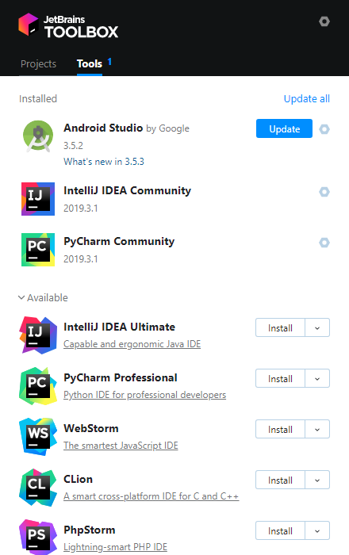
Java - IDE
JetBrains ToolBox (https://www.jetbrains.com/toolbox/)
JetBrains IntelliJ IDEA Community (https://www.jetbrains.com/idea/download/#section=windows)
Licence is required for Ultimate PTE owns education licence
No need for Ultimate

Slide 4
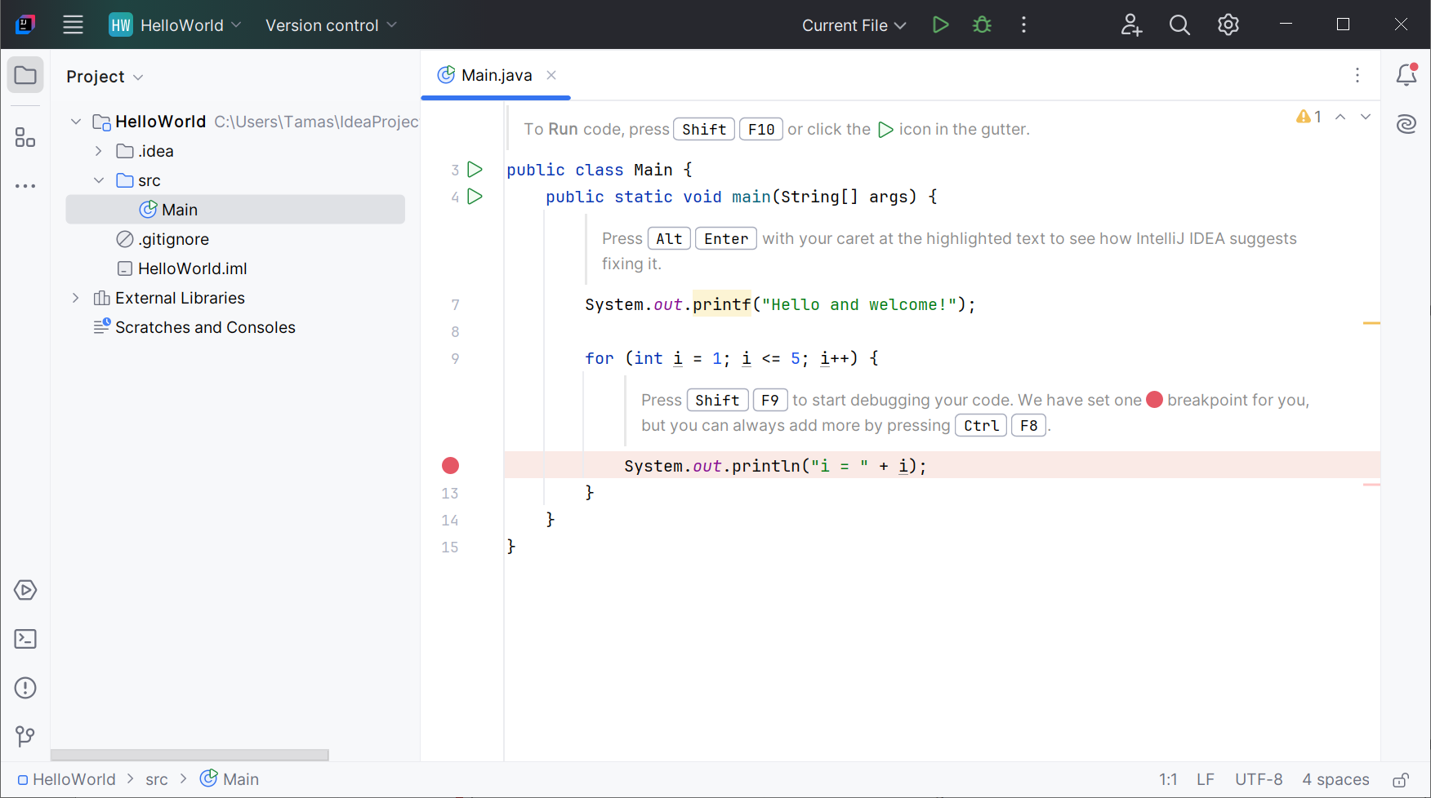
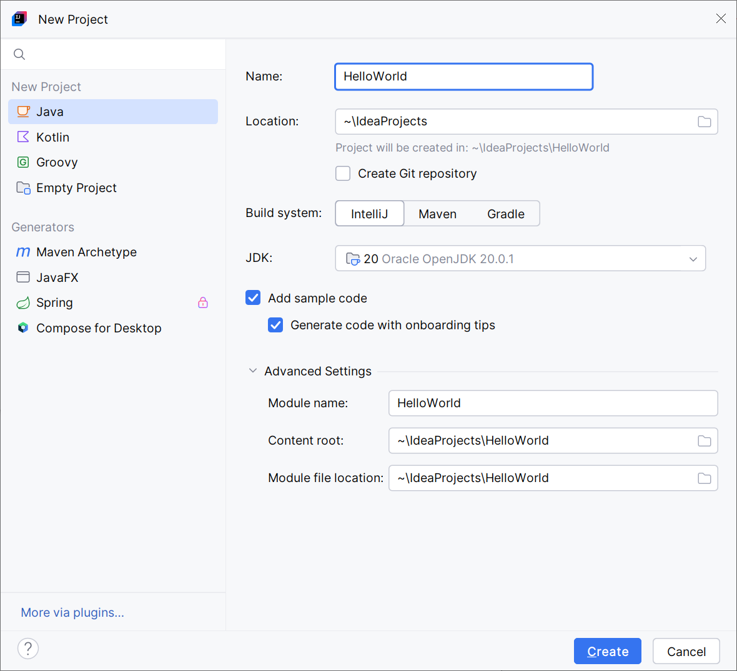
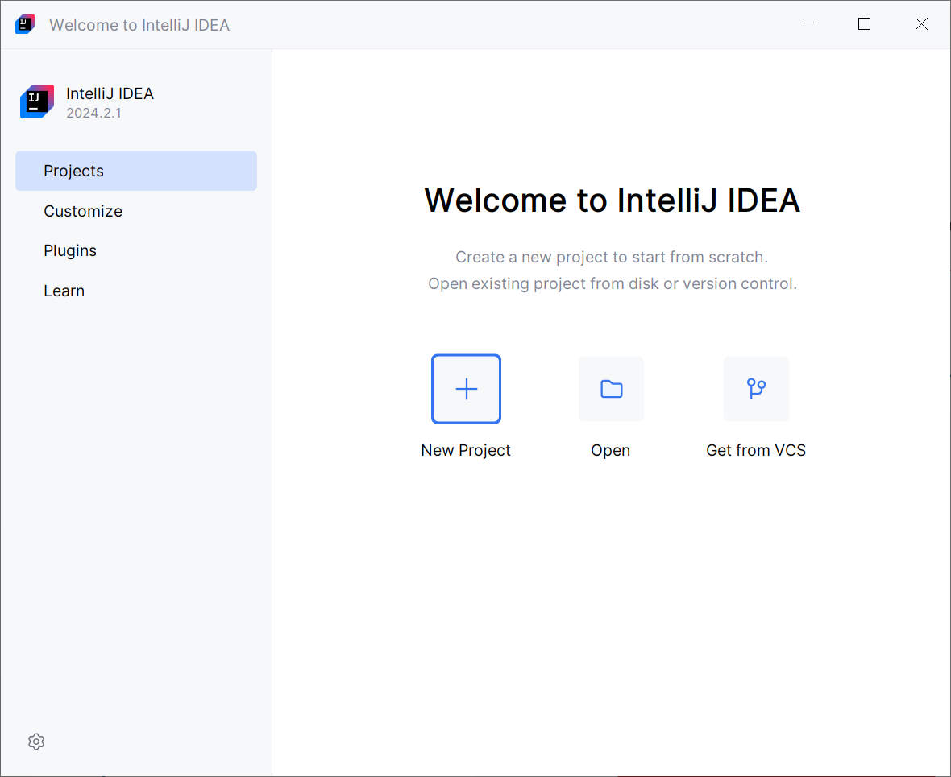
Create First Project

Slide 5
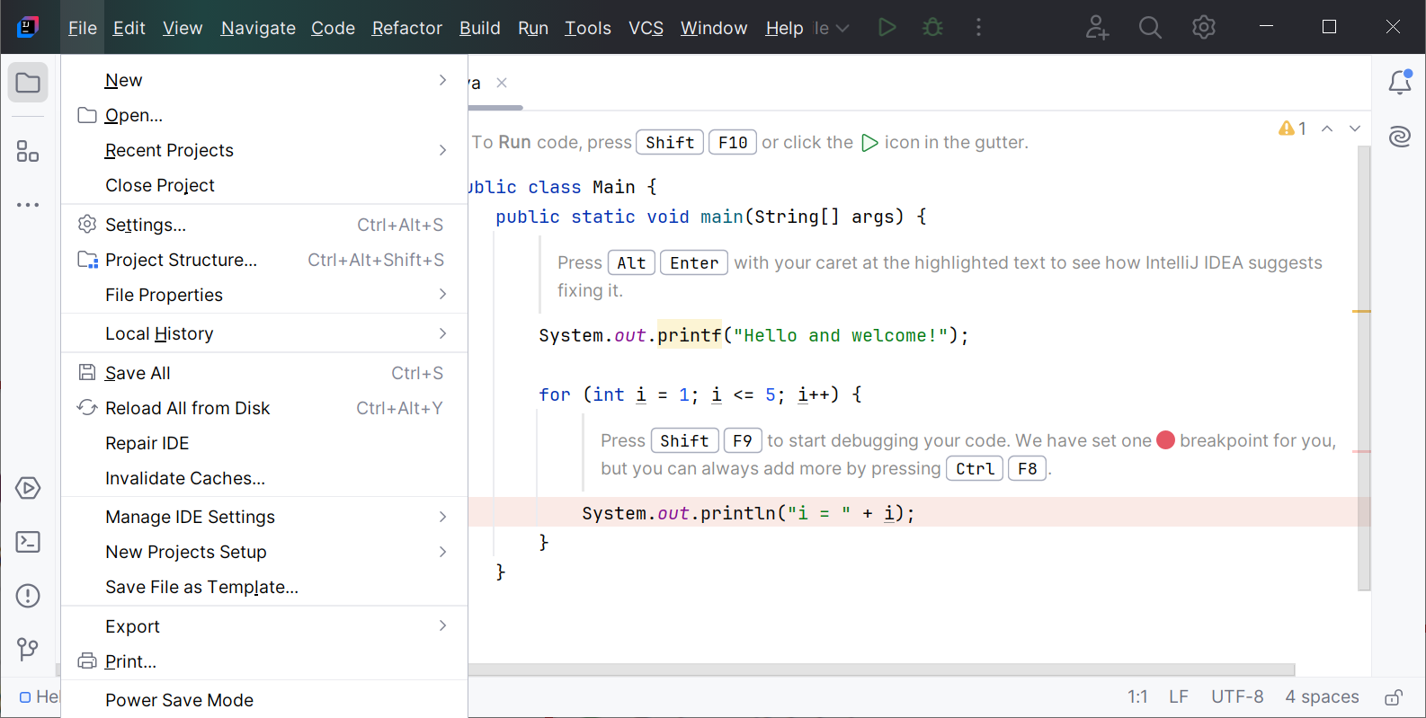
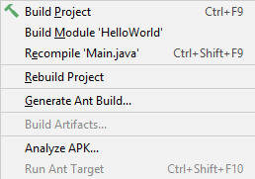
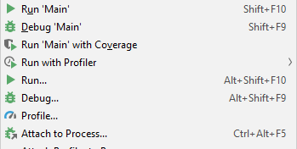
Compile and Run

Slide 6
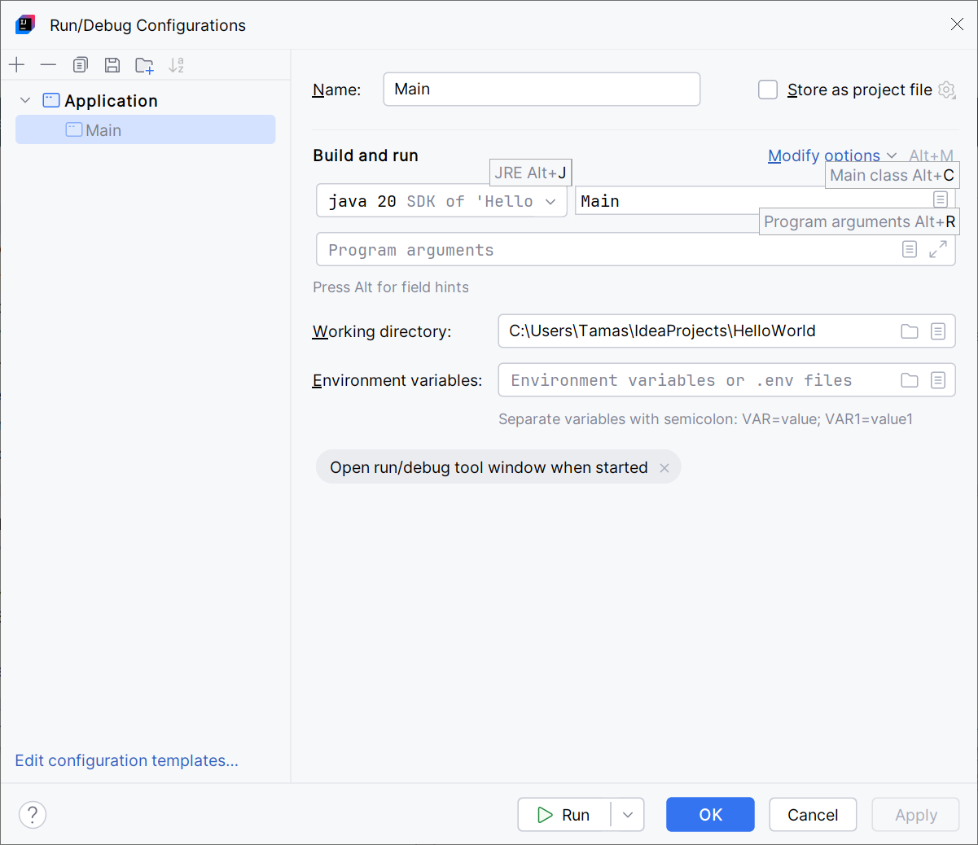
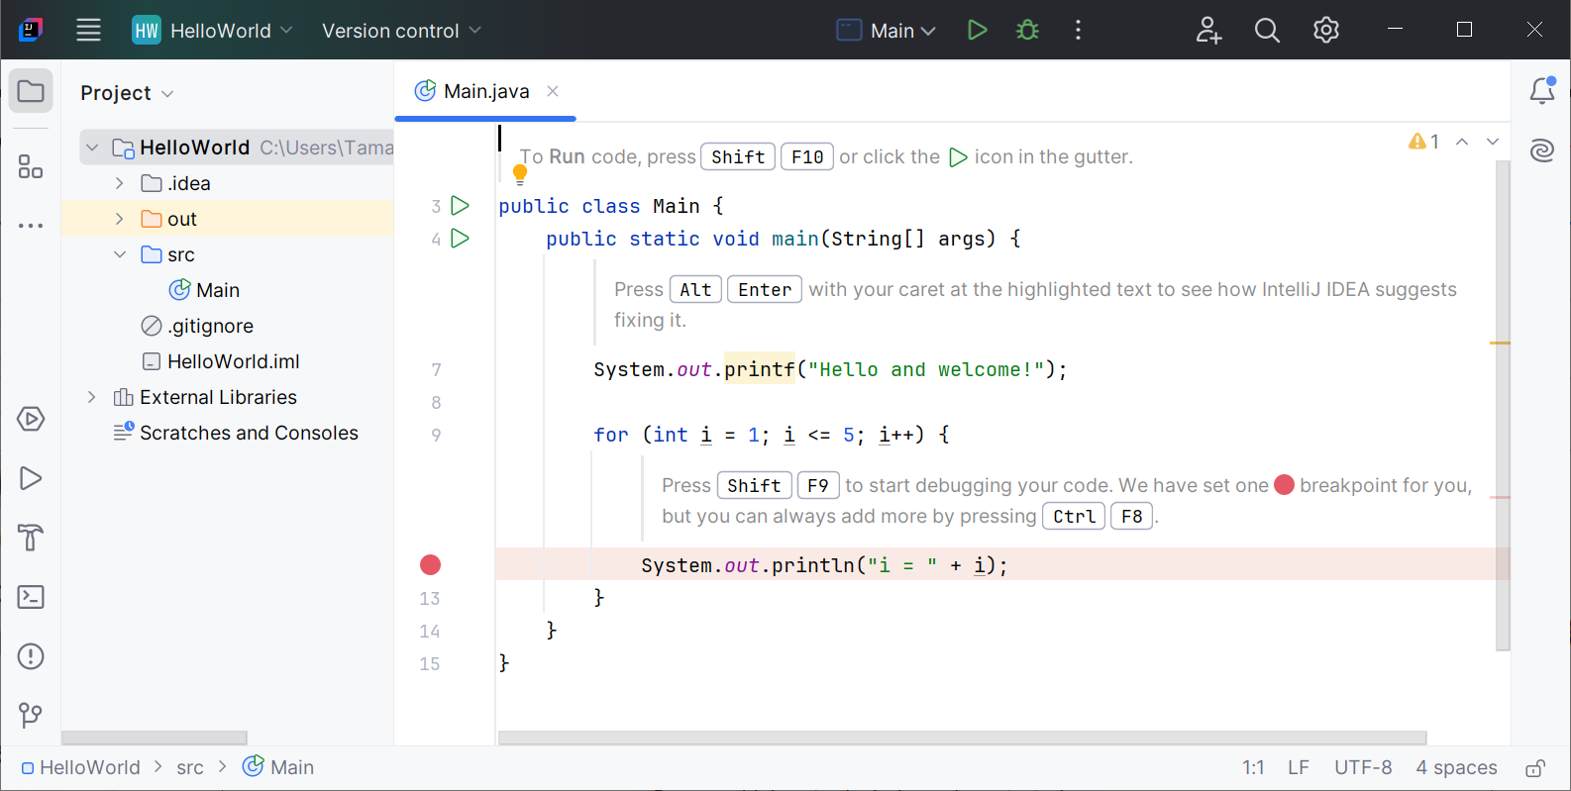
Execution entry points – Run configuration

Slide 7
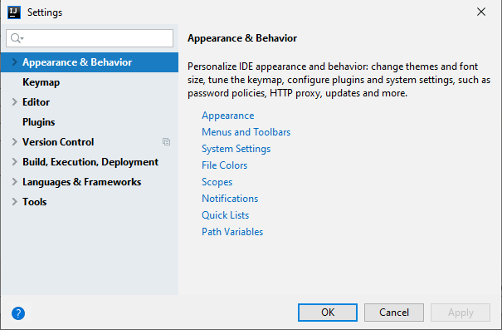
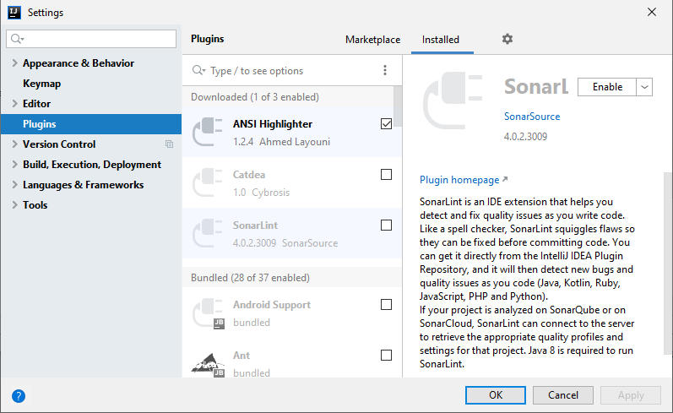
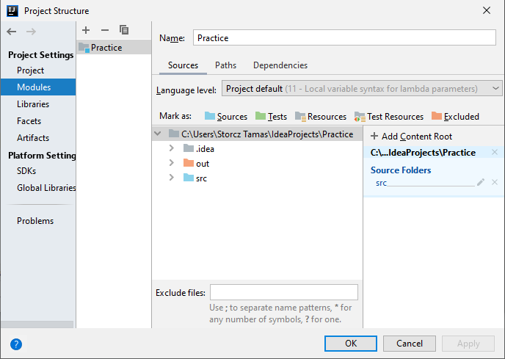
IntelliJ IDEA settings
File/Settings
Plugins (git, maven, JUnit)
File/Project structure

Slide 8
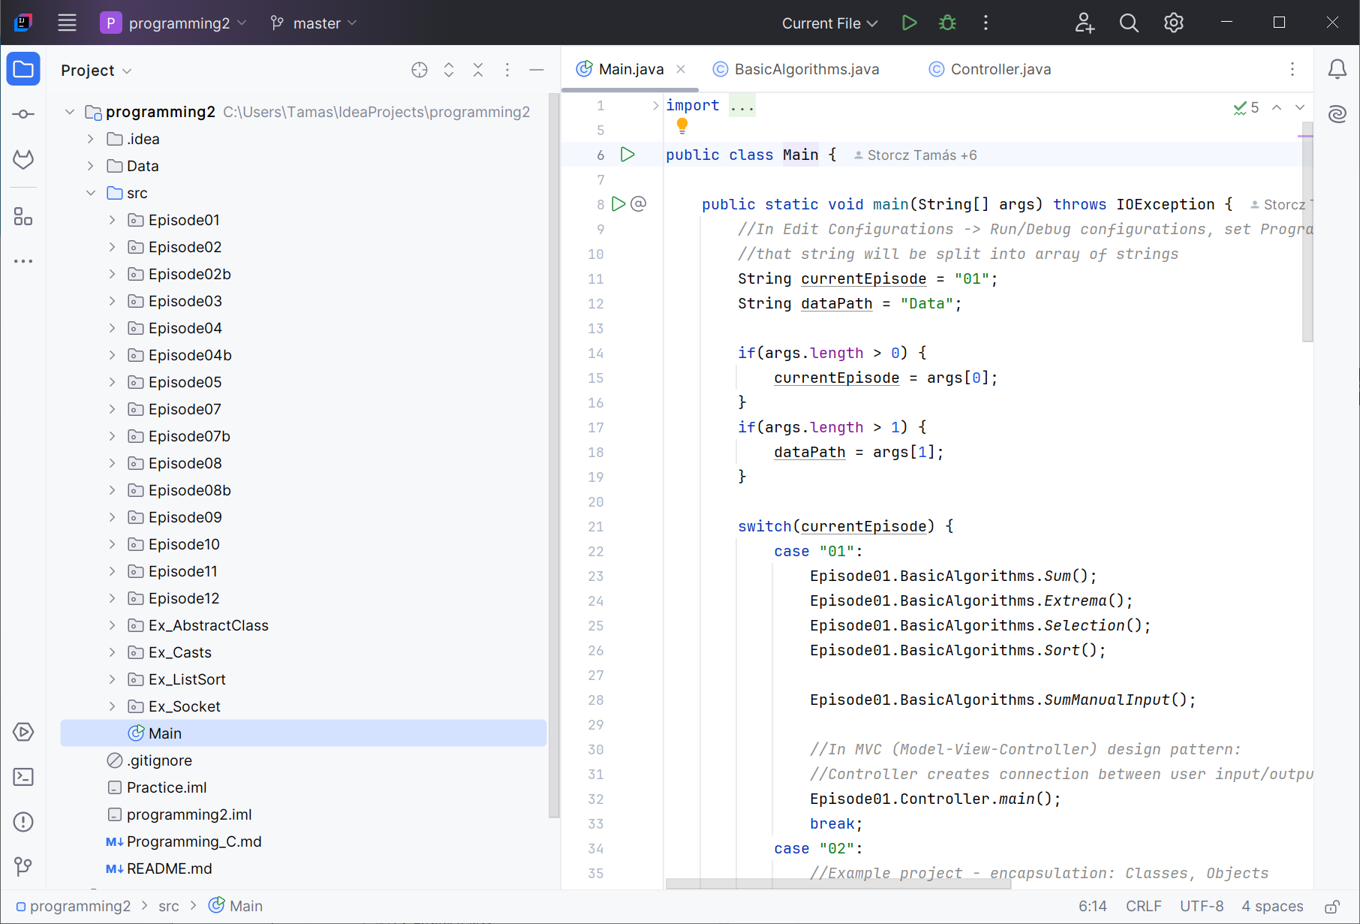
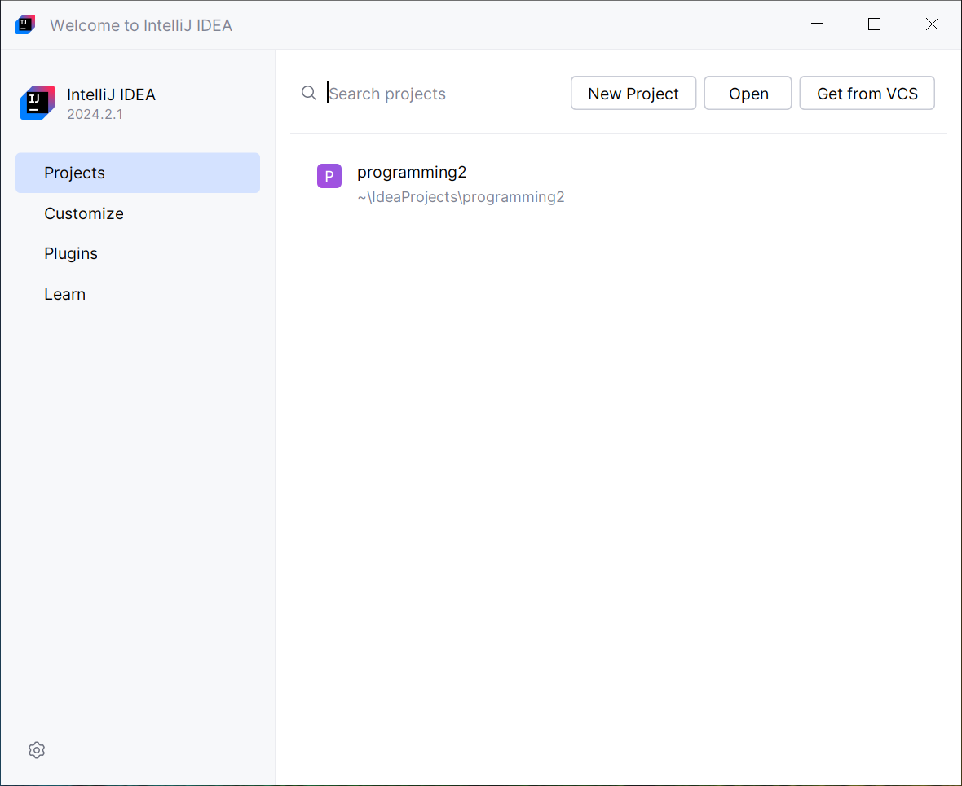
IntelliJ IDEA Community

Slide 9
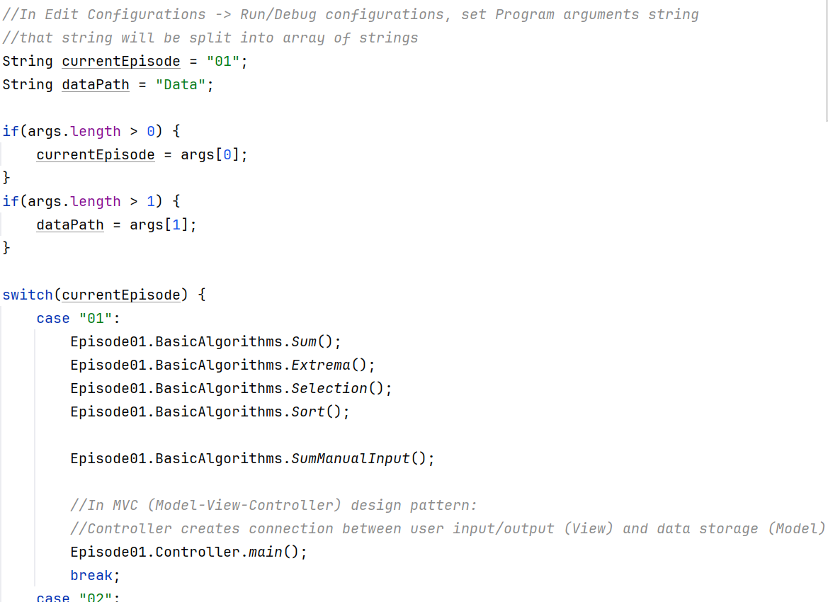
Start of Practice Episodes

Slide 10
IntelliJ IDEA cheat-sheet
Intellisense: Ctrl+Space
Compile: Ctrl+F9 Ctrl+Shift+F9
Run: Shift+F10 Alt+Shift+F10
Auto indent: Ctrl+Alt+i
Restructure code
Reformat code: Ctrl+Alt+l
Generate: Alt+Insert
Intention actions: Alt+Enter
Info: Ctrl+hover
Comment: Ctrl+/, Ctrl+Shift+/
Move line in block: Ctrl+Shift+↑/↓
Surround with: Ctrl+Alt+t

